Slide 1
8. New Research and Application Fields

Slide 2
Main Contents
Data warehouse
OLAP
Data mining
Information retrieval
Semistructured data and XML

Slide 3
8.4 Semistructured Data and XML
How the Web is Today
HTML documents
  often generated by applications
  consumed by humans only
  easy access: across platforms, across organizations
No application interoperability:
  HTML not understood by applications
    screen scraping brittle
  Database technology: client-server
    still vendor specific

Slide 4
New Universal Data Exchange Format: XML
A recommendation from the W3C
XML = data
XML generated by applications
XML consumed by applications
Easy access: across platforms, organizations

Slide 5
Paradigm Shift on the Web
From documents (HTML) to data (XML)
From information retrieval to data management
For databases, also a paradigm shift:
  from relational model to semistructured data
  from data processing to data/query translation
  from storage to transport

Slide 6
Semistructured Data
Origins:
Integration of heterogeneous sources
Data sources with non-rigid structure
  Biological data
  Web data

Slide 7
The Semistructured Data Model
Bib
Object Exchange
Model (OEM)
&o1
complex object
paper
paper
book
references
&o12
&o24
&o29
references
references
author
year
author
author
page
title
http
author
title
publisher
title
author
author
&o43
&96
&25
1997
firstname
firstname
lastname
first
last
lastname
&243
&206
“Serge”
“Abiteboul”
“Victor”
“Vianu”
122
133
atomic object
Notes:
Bib --- bibliograph

Slide 8
Syntax for Semistructured Data
Bib: &o1 { paper: &o12 { … },
book: &o24 { … },
paper: &o29
{ author: &o52 “Abiteboul”,
author: &o96 { firstname: &243 “Victor”,
lastname: &o206 “Vianu”},
title: &o93 “Regular path queries with constraints”,
references: &o12,
references: &o24,
pages: &o25 { first: &o64 122, last: &o92 133}
}
}
Observe: Nested tuples, set-values, oids !

Slide 9
Syntax for Semistructured Data
May omit oids:
{ paper: { author: “Abiteboul”,
author: { firstname: “Victor”,
lastname: “Vianu”},
title: “Regular path queries …”,
page: { first: 122, last: 133 }
}
}

Slide 10
Characteristics of Semistructured Data
Missing or additional attributes
Multiple attributes
Different types in different objects
Heterogeneous collections
Self-describing, irregular data, no a priori structure

Slide 11
Comparison with Relational Data
name | phone
John | 3634
Sue | 6343
Dick | 6363
row
row
row
name
phone
name
phone
name
phone
“John”
3634
“Sue”
6343
“Dick”
6363
{ row: { name: “John”, phone: 3634 },
row: { name: “Sue”, phone: 6343 },
row: { name: “Dick”, phone: 6363 }
}

Slide 12

XML
A W3C standard to complement HTML
Origins: Structured text SGML
  Large-scale electronic publishing
  Data exchange on the web
Motivation:
  HTML describes presentation
  XML describes content
http://www.w3.org/TR/2000/REC-xml-20001006 (version 2, 10/2000)

Slide 13
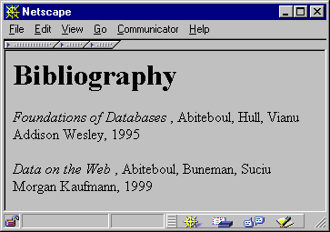
From HTML to XML
HTML describes the presentation

Slide 14
HTML
<h1> Bibliography </h1>
<p> <i> Foundations of Databases </i>
Abiteboul, Hull, Vianu
<br> Addison Wesley, 1995
<p> <i> Data on the Web </i>
Abiteboul, Buneman, Suciu
<br> Morgan Kaufmann, 1999

Slide 15
XML
<bibliography>
  <book> <title> Foundations… </title>
  <author> Abiteboul </author>
  <author> Hull </author>
  <author> Vianu </author>
  <publisher> Addison Wesley </publisher>
  <year> 1995 </year>
  </book>
  …
</bibliography>
XML describes the content

Slide 16
Why are we DB’ers interested?
It’s data, stupid. That’s us.
Proof by Google:
  database+XML – 1,940,000 pages.
Database issues:
  How are we going to model XML? (graphs)
  How are we going to query XML? (XQuery)
  How are we going to store XML (in a relational database? object-oriented? native?)
  How are we going to process XML efficiently? (many interesting research questions !)

Slide 17
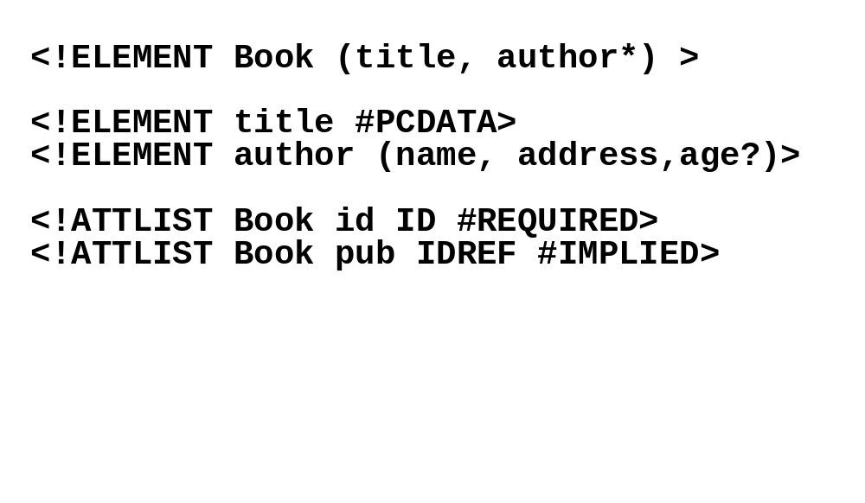
Document Type Descriptors
Sort of like a schema but not really.
Inherited from SGML DTD standard
BNF grammar establishing constraints on element structure and content
Definitions of entities

Slide 18
Shortcomings of DTDs
Useful for documents, but not so good for data:
Element name and type are associated globally
No support for structural re-use
  Object-oriented-like structures aren’t supported
No support for data types
  Can’t do data validation
Can have a single key item (ID), but:
  No support for multi-attribute keys
  No support for foreign keys (references to other keys)
  No constraints on IDREFs (reference only a Section)

Slide 19
XML Schema
In XML format
Element names and types associated locally
Includes primitive data types (integers, strings, dates, etc.)
Supports value-based constraints (integers > 100)
User-definable structured types
Inheritance (extension or restriction)
Foreign keys
Element-type reference constraints

Slide 20
Sample XML Schema
<schema version=“1.0” xmlns=“http://www.w3.org/1999/XMLSchema”>
<element name=“author” type=“string” />
<element name=“date” type = “date” />
<element name=“abstract”>
<type>
…
</type>
</element>
<element name=“paper”>
<type>
<attribute name=“keywords” type=“string”/>
<element ref=“author” minOccurs=“0” maxOccurs=“*” />
<element ref=“date” />
<element ref=“abstract” minOccurs=“0” maxOccurs=“1” />
<element ref=“body” />
</type>
</element>
</schema>

Slide 21
Important XML Standards
XSL/XSLT: presentation and transformation standards
RDF: resource description framework (meta-info such as ratings, categorizations, etc.)
Xpath/Xpointer/Xlink: standard for linking to documents and elements within
Namespaces: for resolving name clashes
DOM: Document Object Model for manipulating XML documents
SAX: Simple API for XML parsing
XQuery: query language

Slide 22
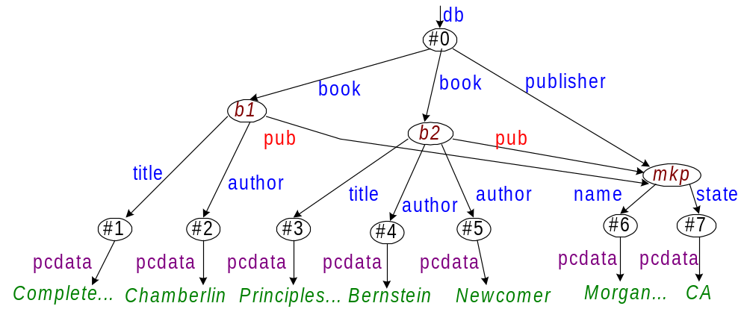
XML Data Model (Graph)
Issues:
Distinguish between attributes and sub-elements?
Should we conserve order?

Slide 23
XML Terminology
Tags: book, title, author, …
  start tag: <book>, end tag: </book>
Elements: <book>…<book>,<author>…</author>
  elements can be nested
  empty element: <red></red> (Can be abbrv. <red/>)
XML document: Has a single root element
Well-formed XML document: Has matching tags
Valid XML document: conforms to a schema

Slide 24
More XML: Attributes
<book price = “55” currency = “USD”>
<title> Foundations of Databases </title>
<author> Abiteboul </author>
…
<year> 1995 </year>
</book>
Attributes are alternative ways to represent data

Slide 25
More XML: Oids and References
<person id=“o555”> <name> Jane </name> </person>
<person id=“o456”> <name> Mary </name>
<children idref=“o123 o555”/>
</person>
<person id=“o123” mother=“o456”><name>John</name>
</person>
oids and references in XML are just syntax

Slide 26
XML-Query Data Model
Describes XML data as a tree
Node ::= DocNode |
ElemNode |
ValueNode |
AttrNode |
NSNode |
PINode |
CommentNode |
InfoItemNode |
RefNode
http://www.w3.org/TR/query-datamodel/2/2001

Slide 27
XML-Query Data Model
Element node (simplified definition):
elemNode : (QNameValue,
{AttrNode },
[ ElemNode | ValueNode])
→ ElemNode
QNameValue = means “a tag name”
Reads: “Give me a tag, a set of attributes, a list of elements /values, and I will return an element”

Slide 28
XML Query Data Model
Example:
<book price = “55”
currency = “USD”>
<title> Foundations … </title>
<author> Abiteboul </author>
<author> Hull </author>
<author> Vianu </author>
<year> 1995 </year>
</book>
Book1 = elemNode(book,
{price2, currency3},
[title4,
author5,
author6,
author7,
year8])
price2 = attrNode(…) /* next */
currency3 = attrNode(…)
title4 = elemNode(title, string9)
…

Slide 29
XML Query Data Model
Attribute node:
attrNode : (QNameValue, ValueNode)
→ AttrNode

Slide 30
XML Query Data Model
Example:
<book price = “55”
currency = “USD”>
<title> Foundations … </title>
<author> Abiteboul </author>
<author> Hull </author>
<author> Vianu </author>
<year> 1995 </year>
</book>
price2 = attrNode(price,string10)
string10 = valueNode(…) /* next */
currency3 = attrNode(currency,
string11)
string11 = valueNode(…)

Slide 31
XML Query Data Model
Value node:
ValueNode = StringValue |
BoolValue |
FloatValue …
stringValue : string → StringValue
boolValue : boolean → BoolValue
floatValue : float → FloatValue

Slide 32
XML Query Data Model
Example:
<book price = “55”
currency = “USD”>
<title> Foundations … </title>
<author> Abiteboul </author>
<author> Hull </author>
<author> Vianu </author>
<year> 1995 </year>
</book>
price2 = attrNode(price,string10)
string10 = valueNode(stringValue(“55”))
currency3 = attrNode(currency, string11)
string11 = valueNode(stringValue(“USD”))
title4 = elemNode(title, string9)
string9 = valueNode(stringValue(“Foundations…”))

Slide 33
XML vs. Semistructured Data
Both described best by a graph
Both are schema-less, self-describing
XML is ordered, ssd is not
XML can mix text and elements:
<talk> Making Java easier to type and easier to type
<speaker> Phil Wadler </speaker>
</talk>
XML has lots of other stuff: attributes, entities, processing instructions, comments

Slide 34
Management of XML and Semistructured Data
Based upon slides by Dan Suciu

Slide 35
Path Expressions
Examples:
Bib.paper
Bib.book.publisher
Bib.paper.author.lastname
Given an OEM instance, the value of a path expression p is a set of objects

Slide 36
Path Expressions
Bib
Examples:
DB =
&o1
paper
book
paper
&o12
&o24
references
&o29
references
references
author
year
author
author
page
title
http
author
title
publisher
title
author
author
&o43
&o44
&o45
&o46
&o52
&96
&25
1997
&o47
&o48
&o49
&o50
&o51
last
firstname
lastname
firstname
lastname
first
&o70
&o71
&243
&206
“Serge”
“Abiteboul”
“Victor”
122
133
“Vianu”
Bib.paper={&o12,&o29}
Bib.book.publisher={&o51}
Bib.paper.author.lastname={&o71,&206}

Slide 37
XQuery
Summary:
FOR-LET-WHERE-ORDERBY-RETURN = FLWOR
FOR/LET Clauses
List of tuples
WHERE Clause
List of tuples
ORDERBY/RETURN Clause
Instance of Xquery data model

Slide 38
XQuery
FOR $x in expr -- binds $x to each value in the list expr
LET $x = expr -- binds $x to the entire list expr
  Useful for common subexpressions and for aggregations

Slide 39
FOR v.s. LET
Returns:
<result> <book>...</book></result>
<result> <book>...</book></result>
<result> <book>...</book></result>
...
FOR $x IN document("bib.xml")/bib/book
RETURN <result> $x </result>
Returns:
<result> <book>...</book>
<book>...</book>
<book>...</book>
...
</result>
LET $x IN document("bib.xml")/bib/book
RETURN <result> $x </result>

Slide 40
Path Expressions
Abbreviated Syntax
  /bib/paper[2]/author[1]
  /bib//author
  paper[author/lastname=“Vianu"]
  /bib/(paper|book)/title
Unabbreviated Syntax
  child::bib/descendant::author
  child::bib/descendant-or-self::*/child::author
  parent, self, descendant-or-self, attribute

Slide 41
XQuery
Find all book titles published after 1995:
FOR $x IN document("bib.xml")/bib/book
WHERE $x/year > 1995
RETURN $x/title
Result:
<title> abc </title>
<title> def </title>
<title> ghi </title>

Slide 42
XQuery
For each author of a book by Morgan Kaufmann, list all books she published:
FOR $a IN distinct(document("bib.xml")
/bib/book[publisher=“Morgan Kaufmann”]/author)
RETURN <result>
$a,
FOR $t IN /bib/book[author=$a]/title
RETURN $t
</result>
distinct = a function that eliminates duplicates

Slide 43
XQuery
Result:
<result>
<author>Jones</author>
<title> abc </title>
<title> def </title>
</result>
<result>
<author> Smith </author>
<title> ghi </title>
</result>

Slide 44
XQuery
<big_publishers>
FOR $p IN distinct(document("bib.xml")//publisher)
LET $b := document("bib.xml")/book[publisher = $p]
WHERE count($b) > 100
RETURN $p
</big_publishers>
count = a (aggregate) function that returns the number of elms

Slide 45
XQuery
Find books whose price is larger than average:
LET $a=avg(document("bib.xml")/bib/book/price)
FOR $b in document("bib.xml")/bib/book
WHERE $b/price > $a
RETURN $b

Slide 46
FOR v.s. LET
FOR
Binds node variables → iteration
LET
Binds collection variables → one value

Slide 47
Collections in XQuery
Ordered and unordered collections
  /bib/book/author = an ordered collection
  Distinct(/bib/book/author) = an unordered collection
LET $a = /bib/book → $a is a collection
$b/author → a collection (several authors...)
RETURN <result> $b/author </result>
Returns:
<result> <author>...</author>
<author>...</author>
<author>...</author>
...
</result>

Slide 48
Collections in XQuery
What about collections in expressions ?
$b/price → list of n prices
$b/price * 0.7 → list of n numbers??
$b/price * $b/quantity → list of n*m numbers ??
  Valid only if the two sequences have at most one element
  Atomization
$book1/author eq "Kennedy" - Value Comparison
$book1/author = "Kennedy" - General Comparison

Slide 49
Sorting in XQuery
<publisher_list>
FOR $p IN distinct(document("bib.xml")//publisher)
ORDERBY $p
RETURN <publisher> <name> $p/text() </name> ,
FOR $b IN document("bib.xml")//book[publisher = $p]
ORDERBY $b/price DESCENDING
RETURN <book>
$b/title ,
$b/price
</book>
</publisher>
</publisher_list>

Slide 50
If-Then-Else
FOR $h IN //holding
ORDERBY $h/title
RETURN <holding>
$h/title,
IF $h/@type = "Journal"
THEN $h/editor
ELSE $h/author
</holding>

Slide 51
Existential Quantifiers
FOR $b IN //book
WHERE SOME $p IN $b//para SATISFIES
contains($p, "sailing")
AND contains($p, "windsurfing")
RETURN $b/title

Slide 52
Universal Quantifiers
FOR $b IN //book
WHERE EVERY $p IN $b//para SATISFIES
contains($p, "sailing")
RETURN $b/title

Slide 53
Other Stuff in XQuery
If-then-else
Universal and existential quantifiers
Sorting
Before and After
  for dealing with order in the input
Filter
  deletes some edges in the result tree
Recursive functions

Slide 54
Group-By in Xquery ??
No GROUPBY currently in XQuery
A recent proposal (next)
  What do YOU think ?

Slide 55
Group-By in Xquery ??
FOR $b IN document("http://www.bn.com")/bib/book,
$y IN $b/@year
WHERE $b/publisher="Morgan Kaufmann"
RETURN GROUPBY $y
WHERE count($b) > 10
IN <year> $y </year>
← with GROUPBY
SELECT year
FROM Bib
WHERE Bib.publisher="Morgan Kaufmann"
GROUPBY year
HAVING count(*) > 10
Equivalent SQL →

Slide 56
Group-By in Xquery ??
FOR $b IN document("http://www.bn.com")/bib/book,
$a IN $b/author,
$y IN $b/@year
RETURN GROUPBY $a, $y
IN <result> $a,
<year> $y </year>,
<total> count($b) </total>
</result>
← with GROUPBY
FOR $a IN document(“http://www.bn.com”)/ bib/book/author,
$y IN $a/../@year
LET $b = document("http://www.bn.com")/bib/book[author=$a,@year=$y]
RETURN <result> $a,
<year> $y </year>,
<total> count($b) </total>
</result>
Without GROUPBY →
Correct if the GROUPBY is node-identity based
Not equivalent if the GROUPBY is value-based

Slide 57
Group-By in Xquery ??
FOR $b IN document("http://www.bn.com")/bib/book,
$a IN $b/author,
$y IN $b/@year
RETURN GROUPBY $a, $y
IN <result> $a,
<year> $y </year>,
<total> count($b) </total>
</result>
← with GROUPBY
FOR $a IN distinct(document(“http://www.bn.com”)/ bib/book/author)
$y IN distinct(document(“http://www.bn.com”)/bib/book/@year)
LET $b = document("http://www.bn.com")/bib/book[author=$a,@year=$y]
RETURN
IF count($b) > 0
THEN
<result> $a,
<year> $y </year>,
<total> count($b) </total>
</result>
Without GROUPBY →

Slide 58
Group-By in Xquery ??
FOR $b IN document("http://www.bn.com")/bib/book,
$a IN $b/author,
$y IN $b/@year
RETURN GROUPBY $a, $y
IN <result> $a,
<year> $y </year>,
<total> count($b) </total>
</result>
← with GROUPBY
FOR $Tup IN distinct (FOR $b IN document("http://www.bn.com")/bib,
$a IN $b/author,
$y IN $b/@year
RETURN <Tup> <a> $a </a> <y> $y </y> </Tup>),
$a IN $Tup/a/node(),
$y IN $Tup/y/node()
LET $b = document("http://www.bn.com")/bib/book[author=$a,@year=$y]
RETURN <result> $a,
<year> $y </year>,
<total> count($b) </total>
</result>
Without GROUPBY →

Slide 59
Group-By in Xquery ??
FOR $b IN document("http://www.bn.com")/bib/book,
$a IN $b/author,
$y IN $b/@year,
$t IN $b/title,
$p IN $b/publisher
RETURN
GROUPBY $p, $y
IN <result> $p,
<year> $y </year>,
GROUPBY $a
IN <authorEntry>
$a,
GROUPBY $t
IN $t
<authorEntry>
</result>
← Nested GROUPBY’s

